Slide 1
Lecture 05 – Constructor and Destructor
fatimazulfiqar.bulc@bahria.edu.pk

Slide 2
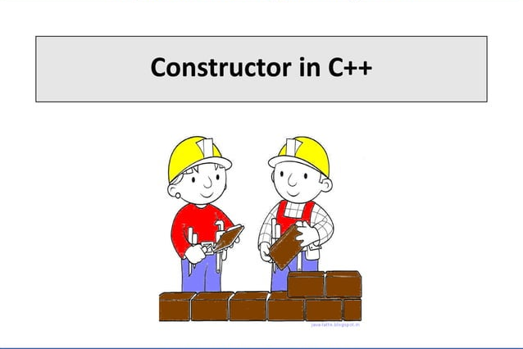
Object Oriented Programming in C++

Slide 3
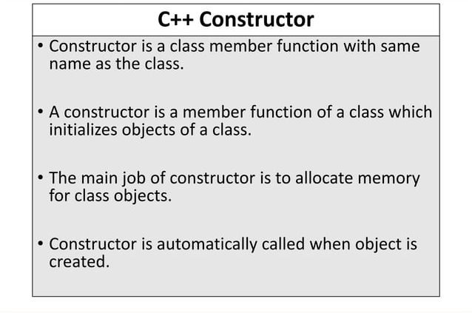
Object Oriented Programming in C++

Slide 4
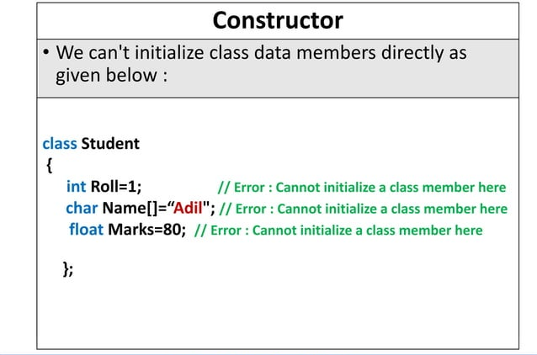
Object Oriented Programming in C++

Slide 5
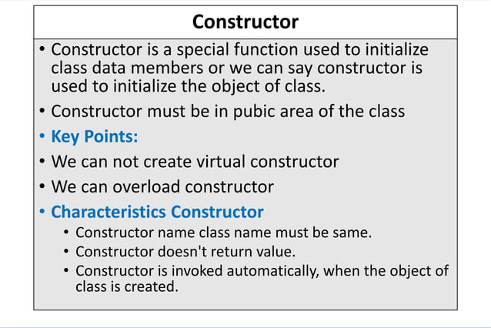
Object Oriented Programming in C++

Slide 6
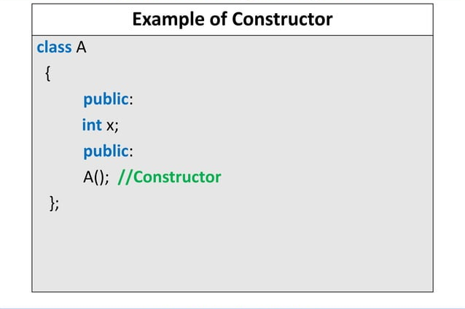
Object Oriented Programming in C++

Slide 7
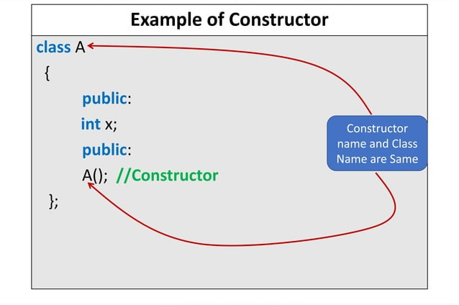
Object Oriented Programming in C++

Slide 8
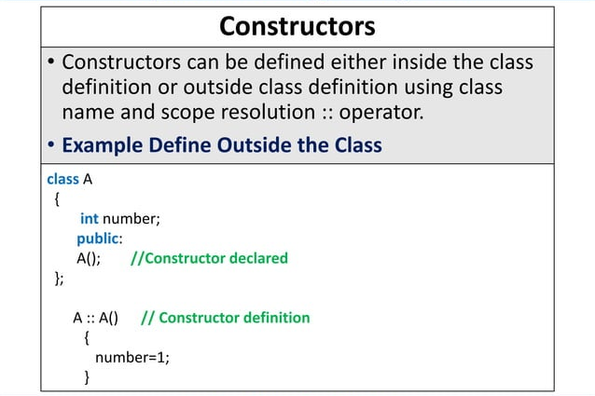
Object Oriented Programming in C++

Slide 9
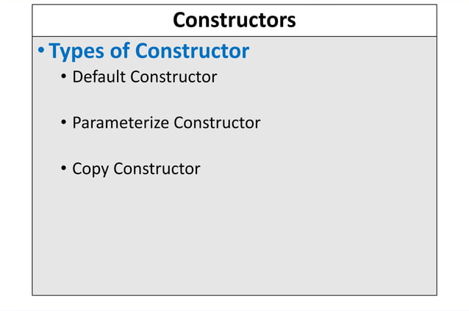
Object Oriented Programming in C++

Slide 10
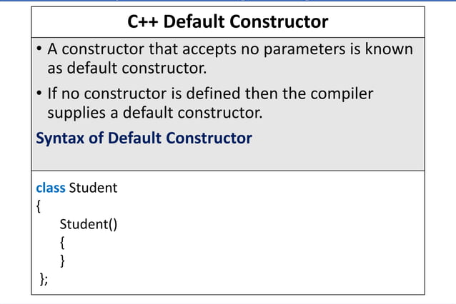
Object Oriented Programming in C++

Slide 11
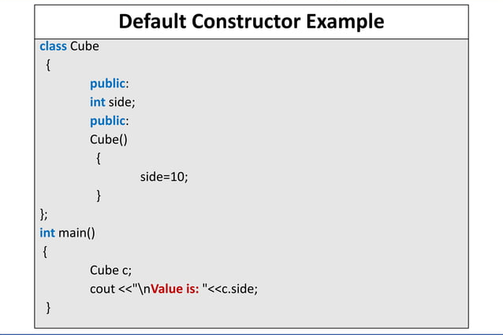
Object Oriented Programming in C++

Slide 12
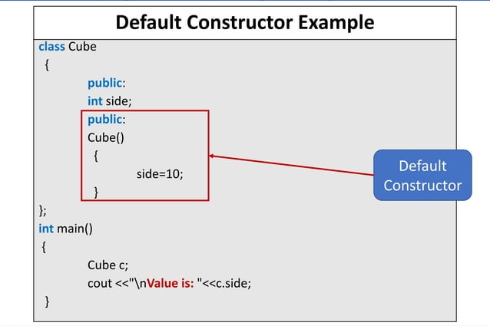
Object Oriented Programming in C++

Slide 13
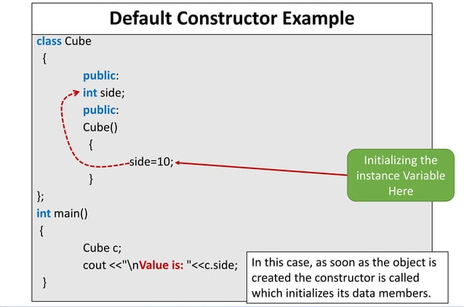
Object Oriented Programming in C++

Slide 14
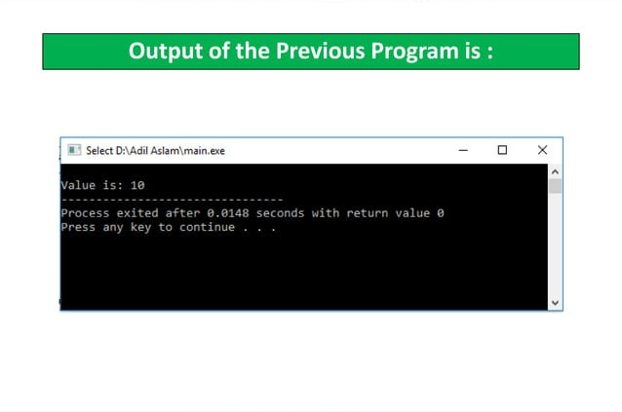
Object Oriented Programming in C++

Slide 15
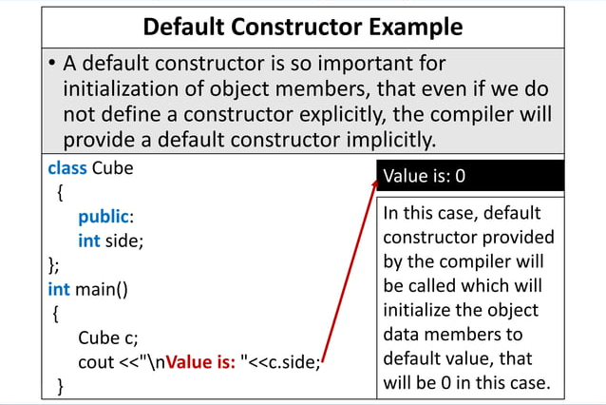
Object Oriented Programming in C++

Slide 16
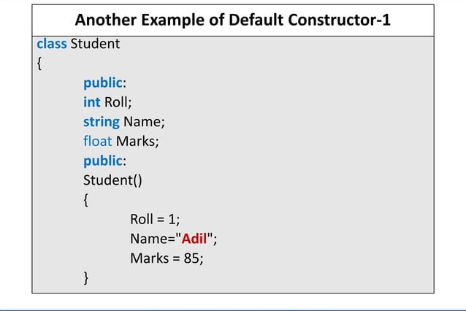
Object Oriented Programming in C++

Slide 17
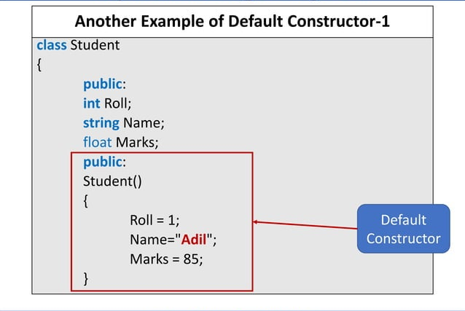
Object Oriented Programming in C++

Slide 18
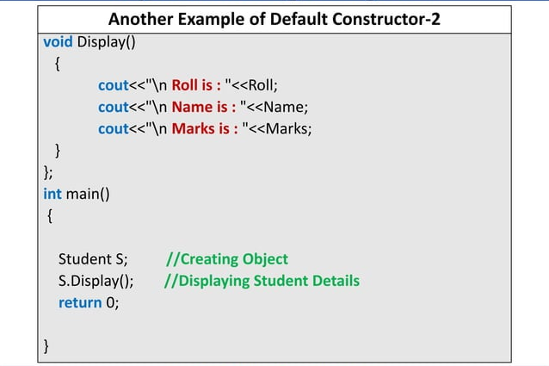
Object Oriented Programming in C++

Slide 19
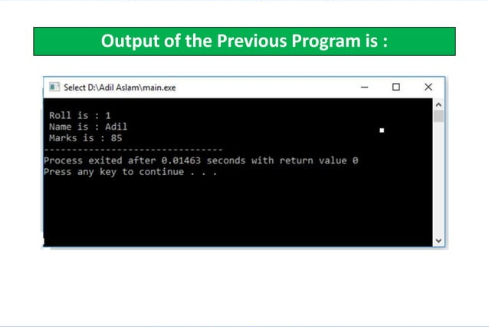
Object Oriented Programming in C++

Slide 20
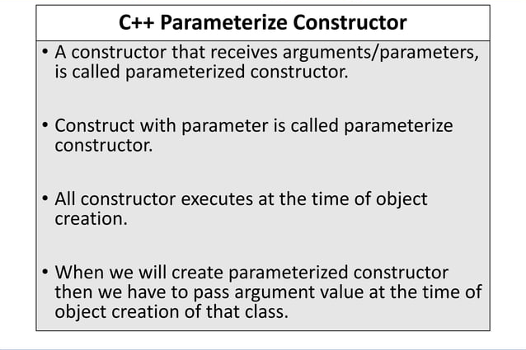
Object Oriented Programming in C++

Slide 21
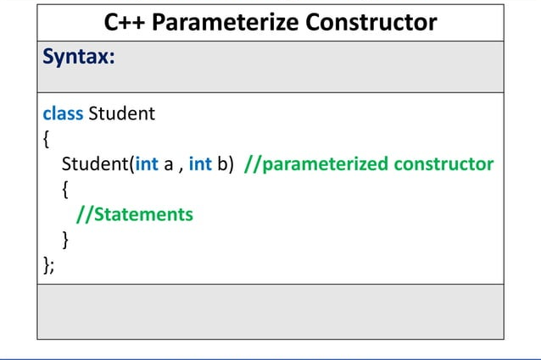
Object Oriented Programming in C++

Slide 22
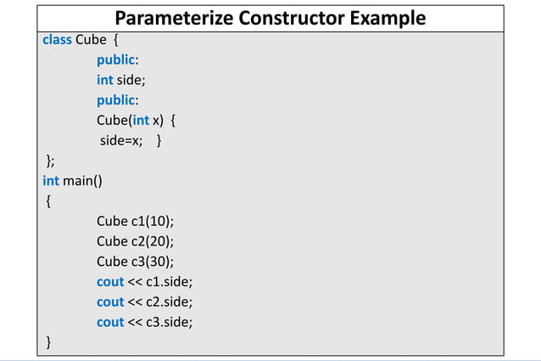
Object Oriented Programming in C++

Slide 23
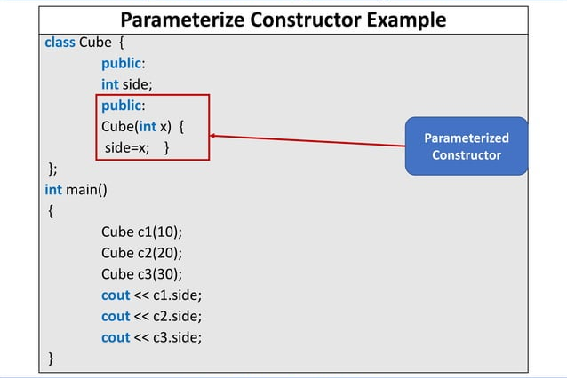
Object Oriented Programming in C++

Slide 24
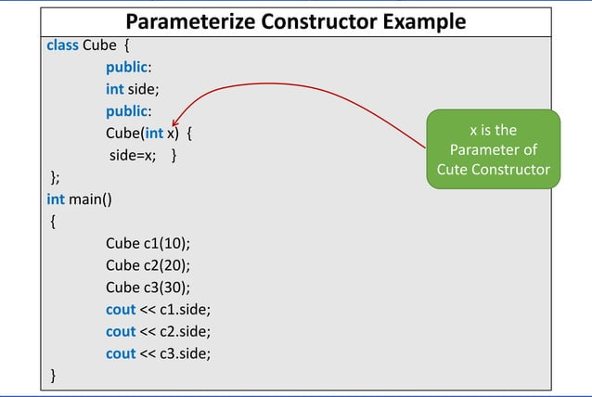
Object Oriented Programming in C++

Slide 25
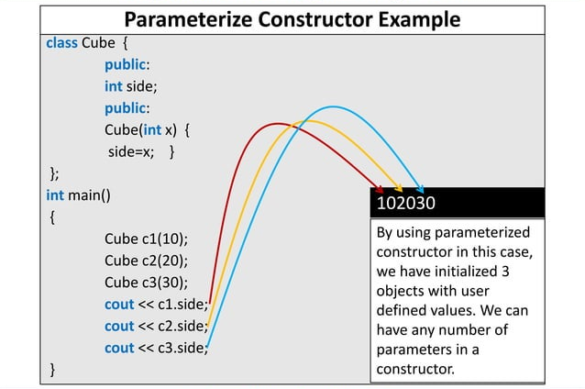
Object Oriented Programming in C++

Slide 26
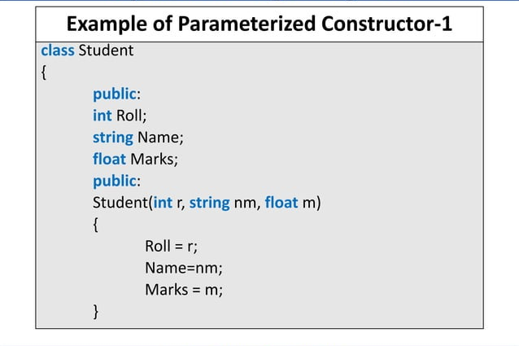
Object Oriented Programming in C++

Slide 27
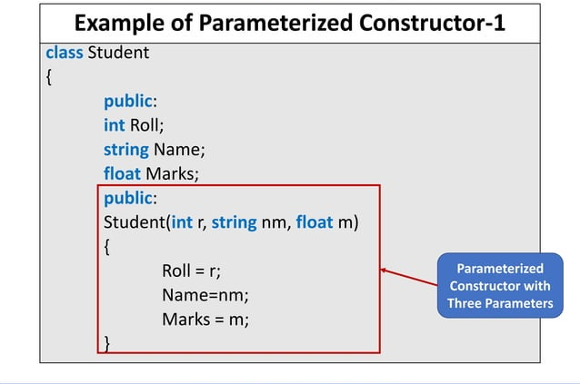
Object Oriented Programming in C++

Slide 28
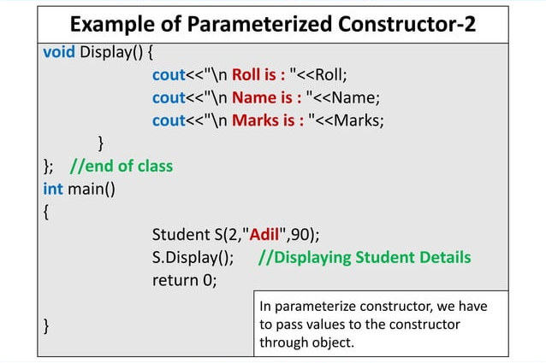
Object Oriented Programming in C++

Slide 29
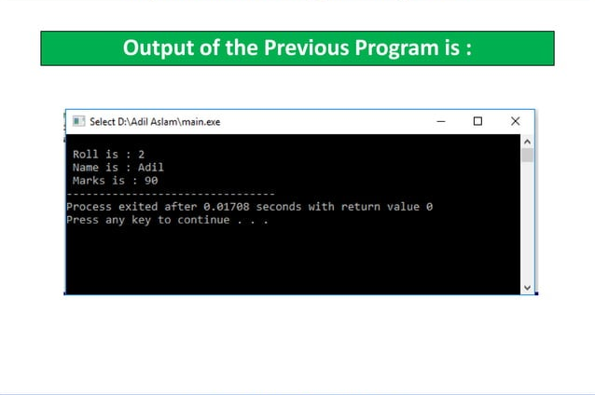
Object Oriented Programming in C++

Slide 30
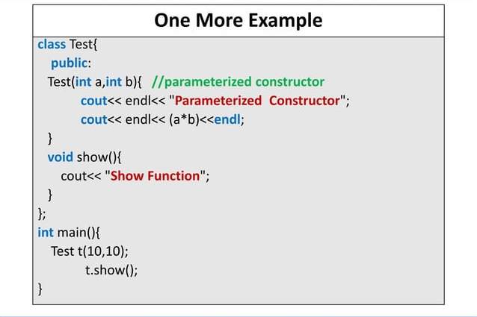
Object Oriented Programming in C++

Slide 31
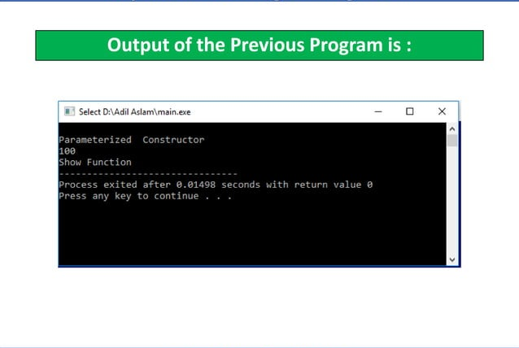
Object Oriented Programming in C++

Slide 32
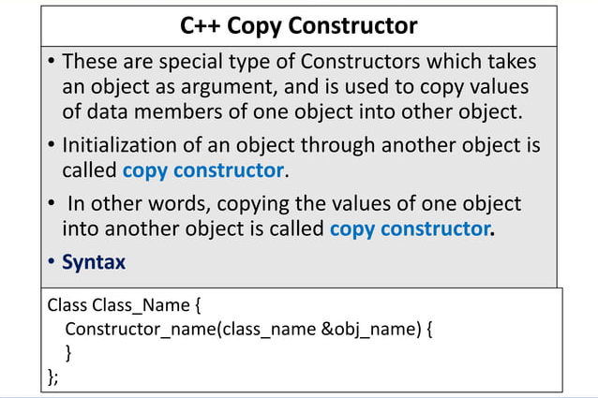
Object Oriented Programming in C++

Slide 33
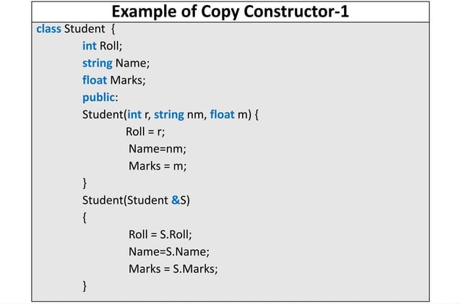
Object Oriented Programming in C++

Slide 34
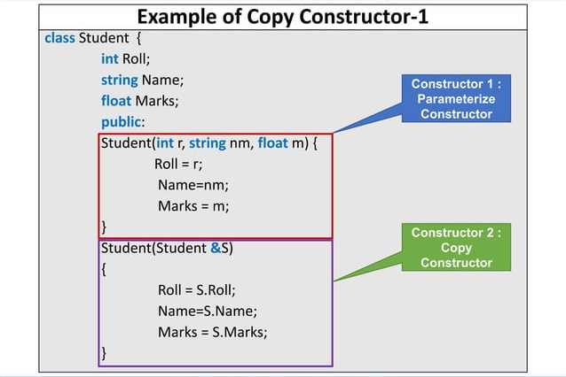
Object Oriented Programming in C++

Slide 35
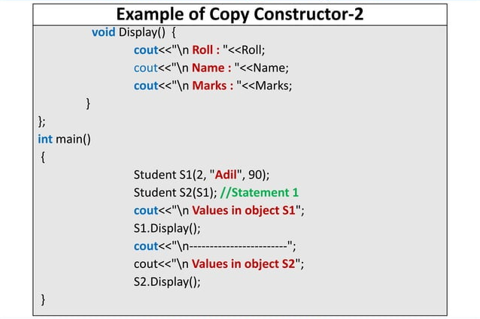
Object Oriented Programming in C++

Slide 36
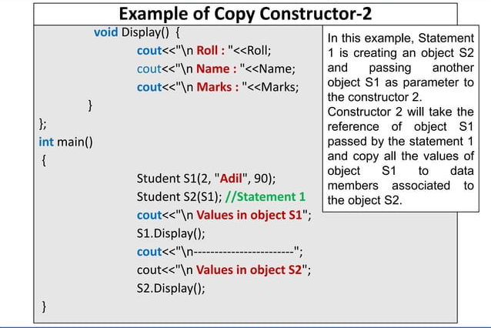
Object Oriented Programming in C++

Slide 37
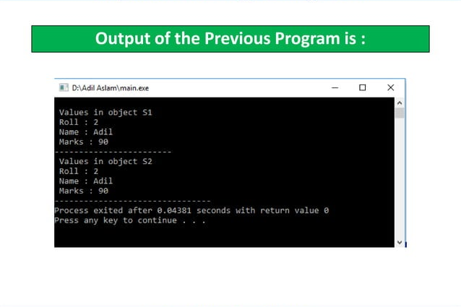
Object Oriented Programming in C++

Slide 38
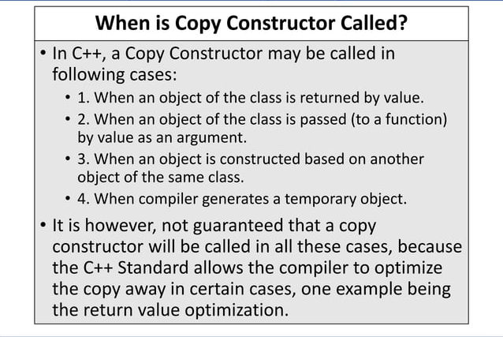
Object Oriented Programming in C++

Slide 39
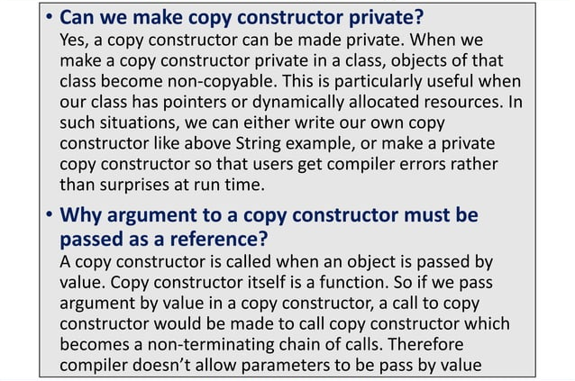
Object Oriented Programming in C++

Slide 40
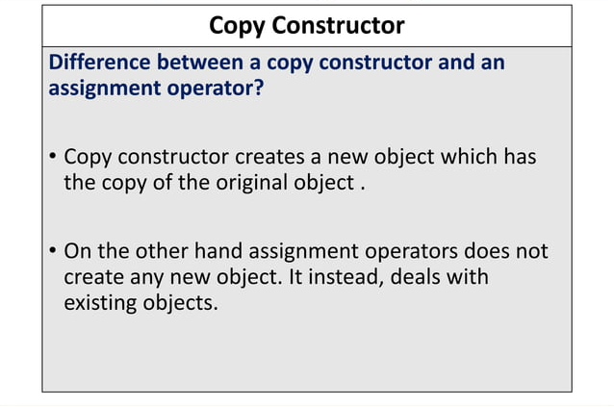
Object Oriented Programming in C++

Slide 41
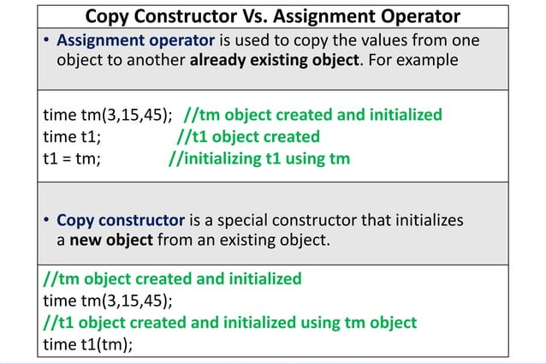
Object Oriented Programming in C++

Slide 42
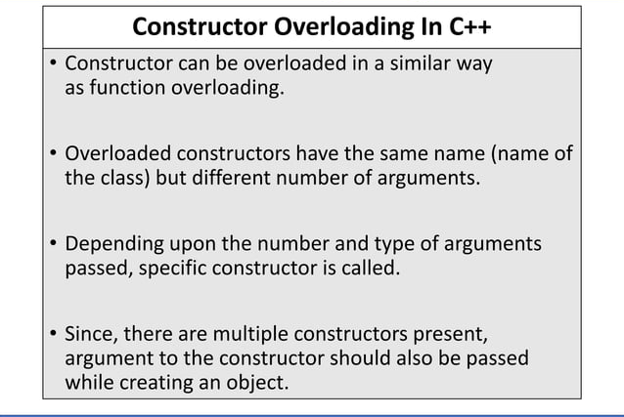
Object Oriented Programming in C++

Slide 43
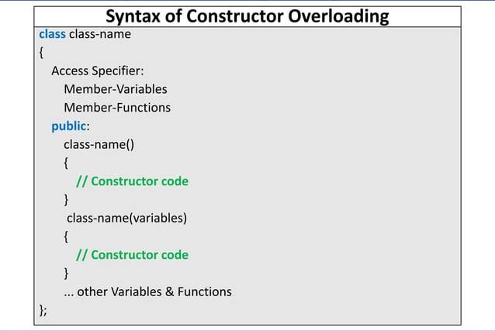
Object Oriented Programming in C++

Slide 44
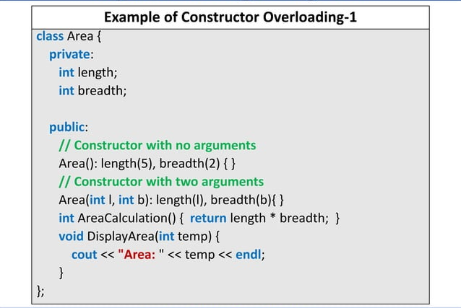
Object Oriented Programming in C++

Slide 45
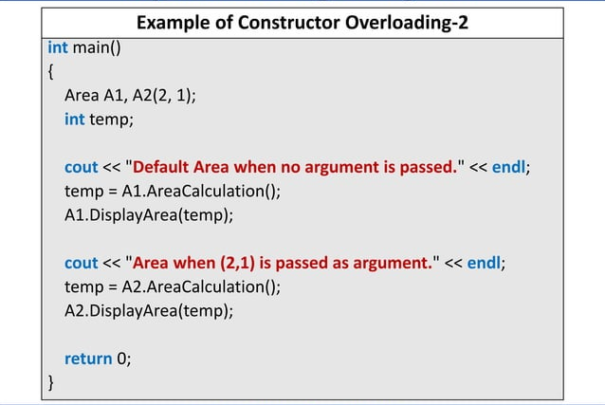
Object Oriented Programming in C++

Slide 46
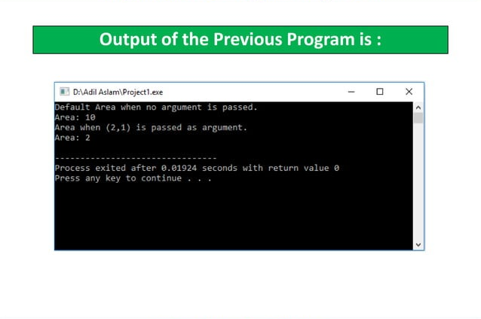
Object Oriented Programming in C++

Slide 47
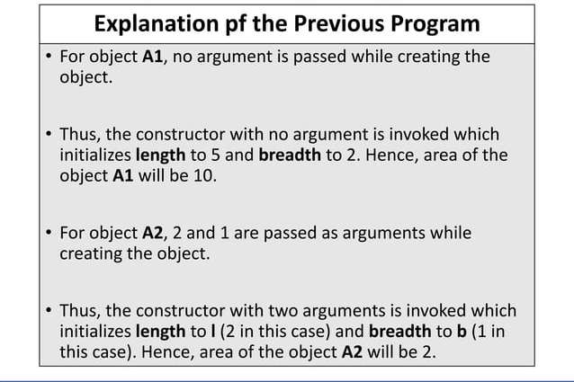
Object Oriented Programming in C++

Slide 48
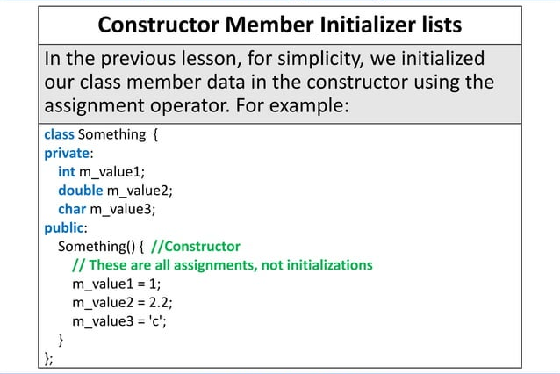
Object Oriented Programming in C++

Slide 49
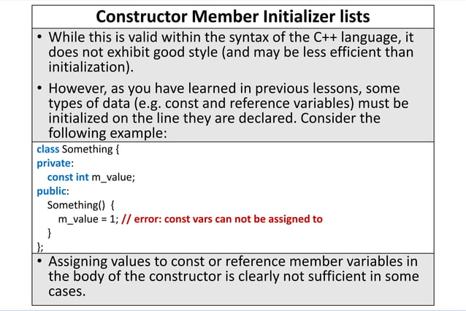
Object Oriented Programming in C++

Slide 50
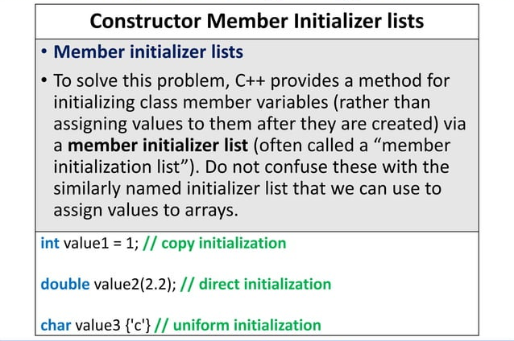
Object Oriented Programming in C++

Slide 51
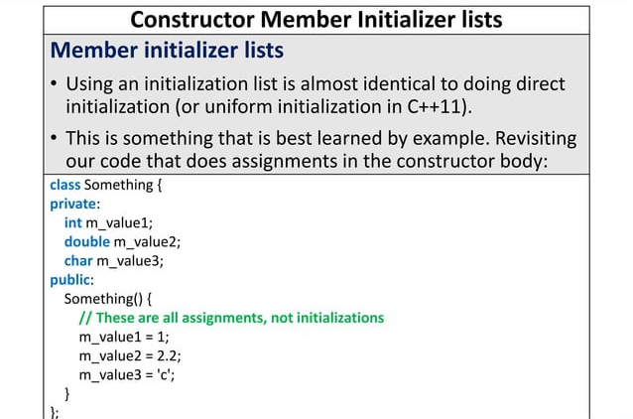
Object Oriented Programming in C++

Slide 52

Object Oriented Programming in C++

Slide 53

Object Oriented Programming in C++

Slide 54

Object Oriented Programming in C++

Slide 55

Object Oriented Programming in C++

Slide 56

Object Oriented Programming in C++

Slide 57

Object Oriented Programming in C++

Slide 58

Object Oriented Programming in C++

Slide 59

Object Oriented Programming in C++

Slide 60

Object Oriented Programming in C++

Slide 61

Object Oriented Programming in C++

Slide 62

Object Oriented Programming in C++

Slide 63

Object Oriented Programming in C++

Slide 64

Object Oriented Programming in C++

Slide 65

Object Oriented Programming in C++

Slide 66

Object Oriented Programming in C++

Slide 67

Object Oriented Programming in C++

Slide 68

Object Oriented Programming in C++

Slide 69

Object Oriented Programming in C++

Slide 70

Object Oriented Programming in C++

Slide 71

Object Oriented Programming in C++

Slide 72

Object Oriented Programming in C++

Slide 73

Object Oriented Programming in C++

Slide 74

Object Oriented Programming in C++

Slide 75

Object Oriented Programming in C++

Slide 76

Object Oriented Programming in C++

Slide 77

Object Oriented Programming in C++

Slide 78

Object Oriented Programming in C++

Slide 79

Object Oriented Programming in C++

Slide 80

Object Oriented Programming in C++

Slide 81

Object Oriented Programming in C++

Slide 82

Object Oriented Programming in C++

Slide 83

Object Oriented Programming in C++

Slide 84

Object Oriented Programming in C++

Slide 85

Object Oriented Programming in C++

Slide 86

Object Oriented Programming in C++

Slide 87

Object Oriented Programming in C++

Slide 88

Object Oriented Programming in C++

Slide 89

Object Oriented Programming in C++

Slide 90

Object Oriented Programming in C++

Slide 91

Object Oriented Programming in C++

Slide 92
In this lecture we covered …
C++ Constructor
Types of Constructor
  Default Constructor
  Parameterized Constructor
  Copy Constructor
When is copy constructor called?
Constructor Overloading
Constructor Member Initializer List

Slide 93
In this lecture we covered …
Destructor in C++
Rules of Destructor
Examples of Destructor
Constructor Chaining

Slide 94

Object Oriented Programming in C++

