Slide 1
AURORA STATE COLLEGE OF TECHNOLOGY
Casiguran, Baler, Maria Aurora

Slide 2
VISION
Situated in three main campuses, Aurora State College of Technology envisions to be the center for academic excellence and seat of bold experiments and technological breakthroughs in the regions through its high caliber, competent and committed faculty, personnel and through its excellent facilities and equipment to be enabler of the people communities of Aurora and catalyst for their growth and development.
IP Address: 125.60.156.154

Slide 3
MISSION
Guided by its philosophy the college commits itself:
To provide the people of Aurora and the larger community excellent and relevant technical and professional training in the sciences, arts, teacher education, agriculture, forestry, fishery, engineering and technology as well as the needed short term courses; and
To promote research, advantage studies and academic leadership in the stated areas of specification; and,
To extend its services to increasing number of students and other clienteles in Aurora and neighboring provinces.
IP Address: 125.60.156.154

Slide 4
Aurora State College of Technology
Is a public college in the Philippines. It is mandated to provide technical and professional training in the sciences, arts, teacher education, agriculture, engineering and technology and short-term vocational courses.
Source: Wikipedia

Slide 5
It is also mandated to promote research, advanced studies and academic leadership in its areas of specialization. Its main campus is located in Baler, Aurora.

Slide 6
General Information
Homepage : http://ascot.edu.ph/
Phone+63(42)2094354
Address: Sitio Dicaloyungan, Brgy. Zabali Baler, Aurora3200Philippines
Email: admin@ascot.edu.ph
Institution Type: Public
Source: LinkedIn.com

Slide 7
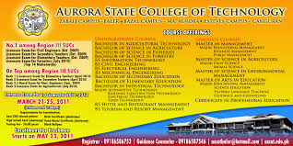
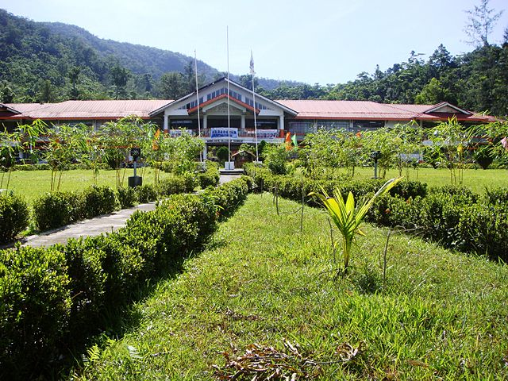
A S C O T

