Slide 2

information and communication technology
INTRODUCTION

Slide 3
WHAT IS ICT?
ICT stands for Information Communication Technology.
Data Information, Knowledge, across devices and networks.
its an essential tool in today’s world that empowers and connects
It includes a wide range of technologies
It manipulates information in various forms
IMAGE
Slide 4

Slide 4

IMAGE

Slide 5
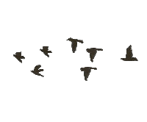

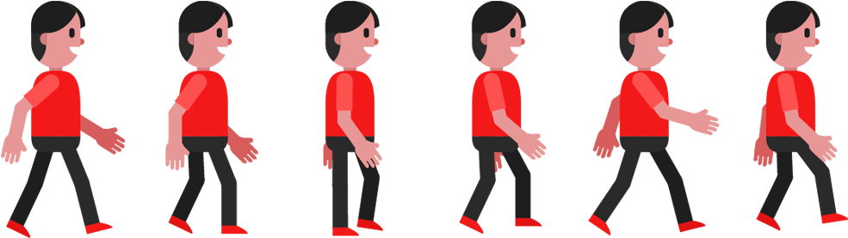

Slide 6
The end

